Slide 1
Barreleye G2 2.0 OU system Thermal Simulation Report rev. R09
Honda Yan
20170327

Slide 2
Revision control table
Rev. | Description | Owner | Date
R08 | Change SSD power consumption from 4.1watt to 5.0 watt. | Honda | 2016/12/30
R09 | Provide simulation data with 2 configs with Micron solutions 1. x24 NVMe HDD 2. x8 NVMe HDD+ x16 Micron SSD with 5 watt | Honda | 2017/03/27

Slide 3
Purpose and Condition
Purpose:
Use Micron 7100 flotherm model to simulate HDD thermal status and provide simulation data with 2 configurations.
1. 24x NVMe HDD
2. 8x NVMe HDD + 16x SSD
Condition
1. All fan run condition.
2. At ambient 35 ﾟC .
CFD Software:
FLOTHERM v11.3

Slide 4
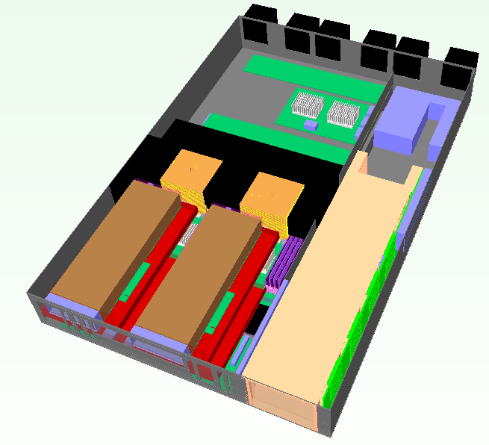
System placement
Fan1
Fan2
Fan3
Fan4
Fan5
Fan6
Expender Board
DIMM x32
VTM
VTM
CPU1
CPU2
2.5” HDD Drawer
Nvidia K80 *2
Power Brick
Air flow direction

Slide 5


System Inlet / Outlet venting
Venting (open ratio=60%)
Front view
Rear view

Slide 6
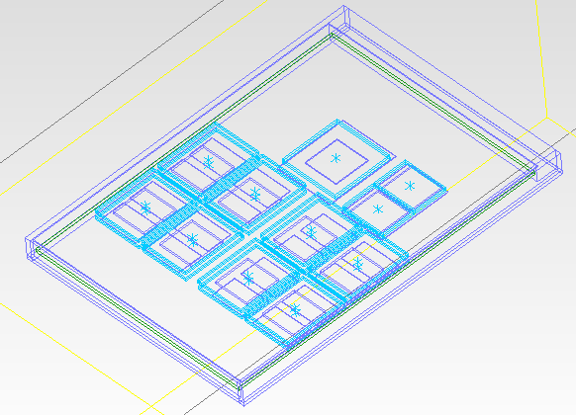
Micron 7100 series Flotherm model
Controller
NAND
Memory
Thermal spec.
Controller : T-junction, 125C
NAND : T-junction, 85C
Memory : T-junction, 100C

Slide 7
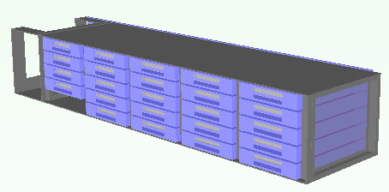
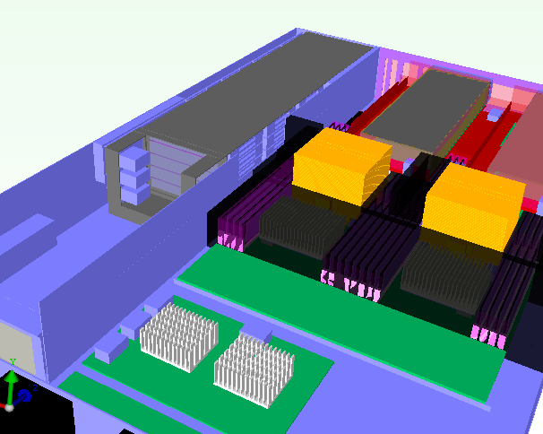
2.5” SSDs Support Location
HDD Q’ty x 24PCS
Sponge to prevent air flow bypass
Venting for HDD

Slide 8
System configuration
Component | TDP (watts) | Q’ty. | Note
Power CPU | 225 | 2 | Spec, Tj, 85C
Memory | 5 | 32 | Spec, Tc, 85C
NVMe HDD | 9.0 | 24 | For configuration_1
NVMe HDD + SSD | 9.0 5.0 | 8 16 | For configuration_2
K80 | 300 | 2 | Spec, 14.5 CFM
VTM | 66 | 2 | Spec, Tc, 110C
6056 Fan |  | 6
Power Brick | 18.11 | 1 | Flotherm Model provided from vendor

Slide 9
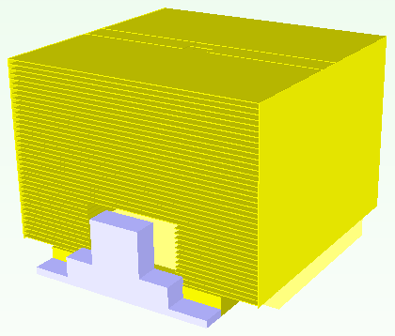
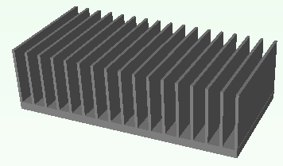
Thermal solution – Heat-sink
85 mm
90 mm
68.2mm
40 mm
CPU HSK
90 x 85x 68.2 mm
Copper base
Cu fin
Heat pipe x4
TIM: Pad K=7.7
VTM HSK
40x80x25 mm
Al extrusion (18 fins)
TIM: Pad K=1.75

Slide 10
Thermal solution – Heat-sink
57.3 mm
VTM HSK-2
57.3x80x32.6 mm
Al extrusion (18 fins)
TIM: Pad K=1.75

Slide 11
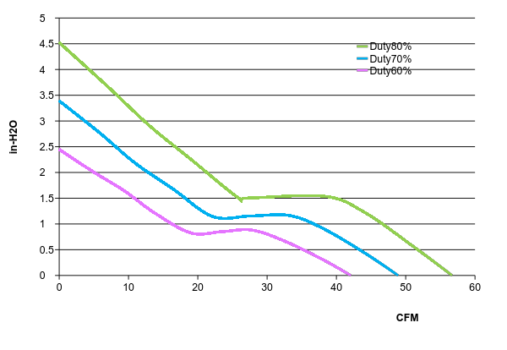
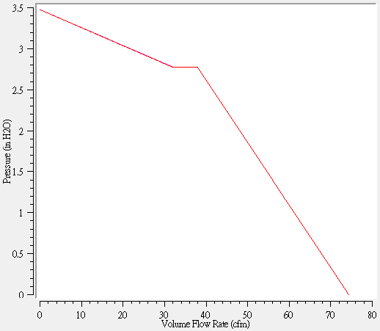
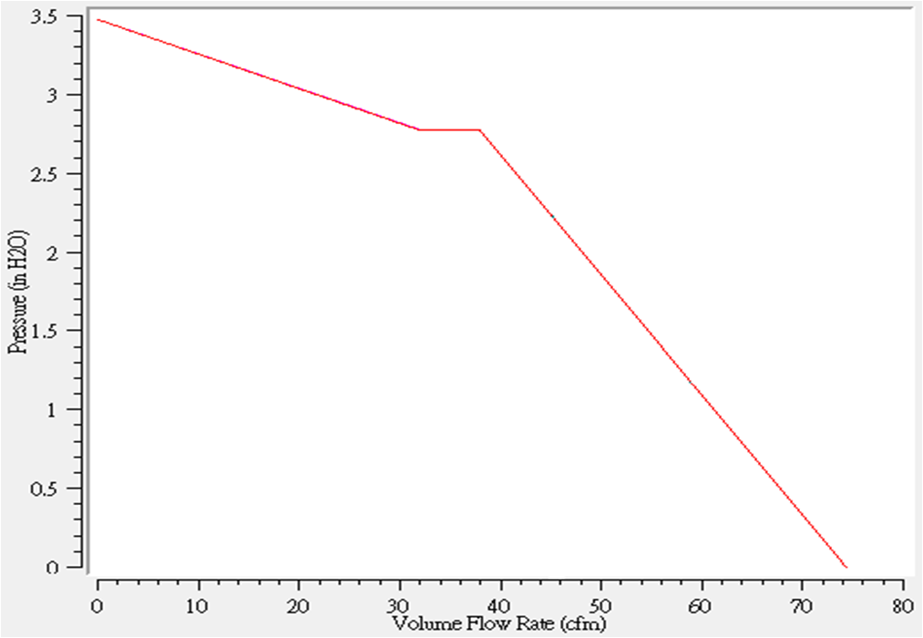
Thermal solution – FAN
PQ curve_PF60561BX-0000-S99_DS 60x60x56mm

Slide 12
Simulation Result – Config_1
Fan condition |  | Normal
System fan duty |  | 6fans, fan duty@100%
Simulation result | SPEC
Ambient Temp | NA | 35
CPU Power | NA | 225
CPU0 Inlet avg. | NA | 40
CPU0 Tj max | 85ﾟC | 80.7
CPU1 Inlet avg. | NA | 41
CPU1 Tj max | 85ﾟC | 79.5
DIMM Temp (Max.) | 75ﾟC | 55.6
VTM Temp(Max.) | 100ﾟC | 92.8
Power Brick, HSP Temp | 115ﾟC | 57.6
SAS chipset Temp | 105ﾟC | 67.8
K80-1 CFM | 14.5 CFM | 17.9
K80-2 CFM | 14.5 CFM | 23.3

Slide 13

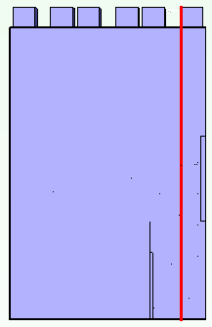
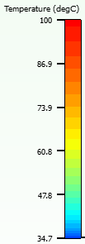
2.5” NVMe HDD Temperature Profile – Config.1
Over thermal spec
x4 NVMe HDDs can meet thermal spec
x5 NVMe HDDs can meet thermal spec
X=470mm

Slide 14
Simulation Result – Config_2
Fan condition |  | Normal
System fan duty |  | 6fans, fan duty@100%
Simulation result | SPEC
Ambient Temp | NA | 35
CPU Power | NA | 225
CPU0 Inlet avg. | NA | 40.2
CPU0 Tj max | 85ﾟC | 80.0
CPU1 Inlet avg. | NA | 41.0
CPU1 Tj max | 85ﾟC | 79.2
DIMM Temp (Max.) | 75ﾟC | 57.4
VTM Temp(Max.) | 100ﾟC | 91.7
Power Brick, HSP Temp | 115ﾟC | 57.1
SAS chipset Temp | 105ﾟC | 66.0
K80-1 CFM | 14.5 CFM | 19.9
K80-2 CFM | 14.5 CFM | 23.6

Slide 15

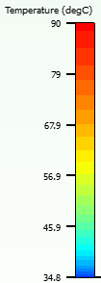
2.5” NVMe HDD Temperature Profile – Config.2
Over thermal spec
x4 SSDs can meet thermal spec
x3 NVMe HDDs and x2 SSDs
can meet thermal spec
x5 NVMe HDDs can meet thermal spec

Slide 16
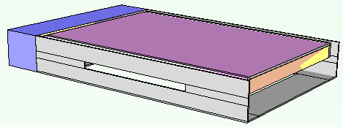
Conclusion
Conclusion :
For configuration_1, system only can support to x9 NVMe HDDs.
For configuration_2, if mix NVMe HDDs with SSDs, the max. support x8 NVMe HDDs and x6 SSDs with 5 watt.
Next Action:
1. For configuration_2, we will try to open venting on HDD carrier. It will help to increase more airflow to go through HDDs, like as following picture.

